Slide 1
CFSI National Advisory Committee Meeting December 8, 2016
Executive Director’s Report

Slide 2
2016 YEAR IN REVIEW: Projects and Programs That Kept Us Busy
Presentation will focus on -
Advocacy
Education and Outreach
Tributes and Recognitions
Communications
Fundraising
Management

Slide 3
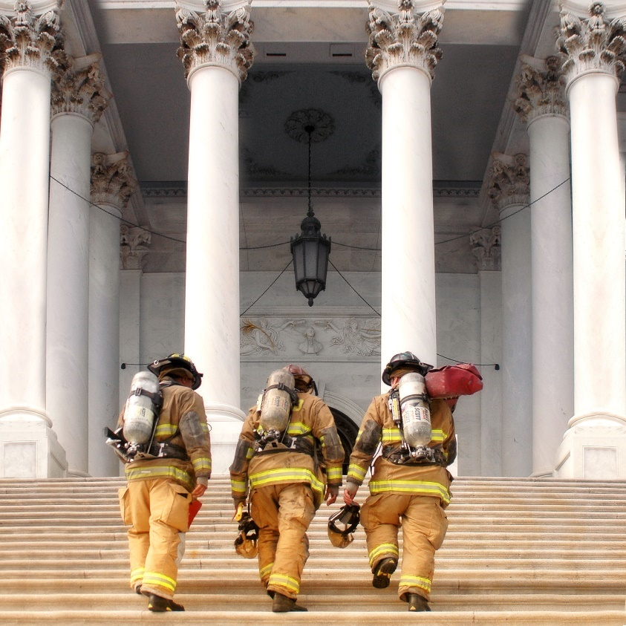
ADVOCACY
Our Work on Capitol Hill
Advocated for issues supported by the NAC.
Recruited members of Congress to serve on the Congressional Fire Services Caucus.
Responded to congressional inquiries.
Organized and attended meetings with members of Congress and staff.

Slide 4
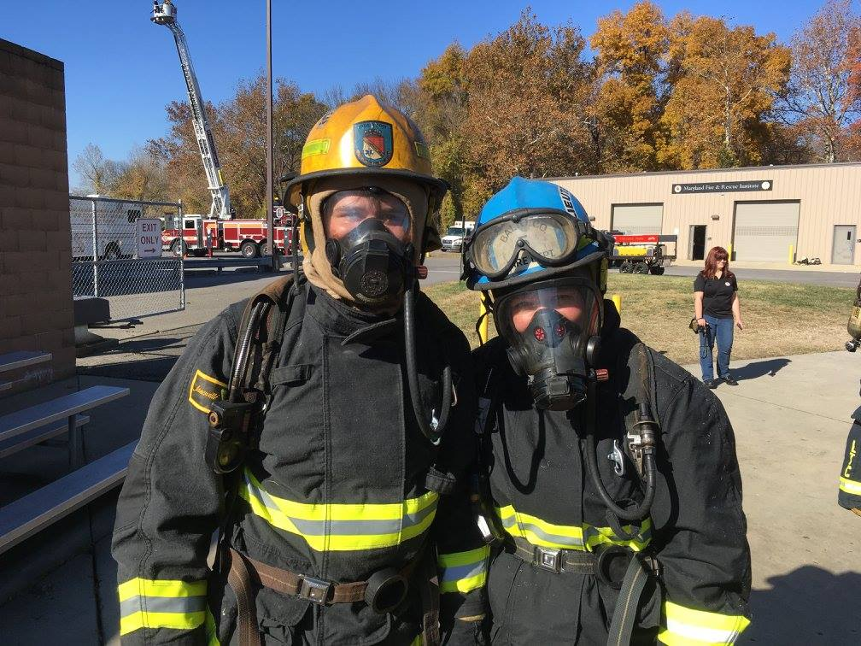
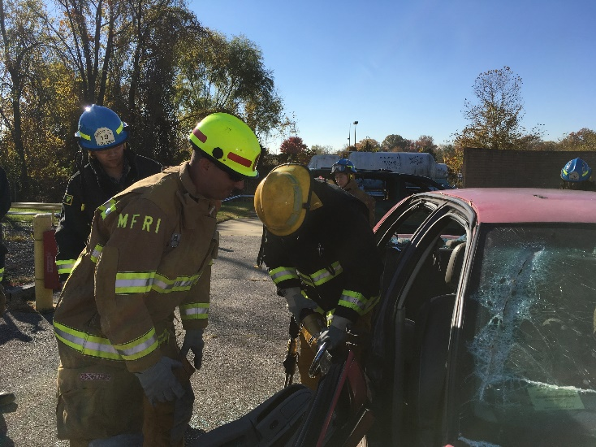
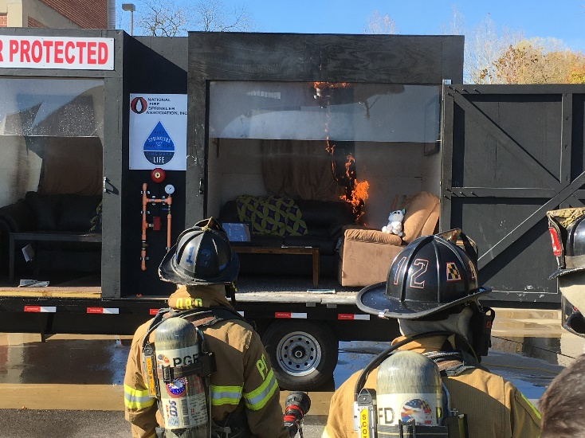
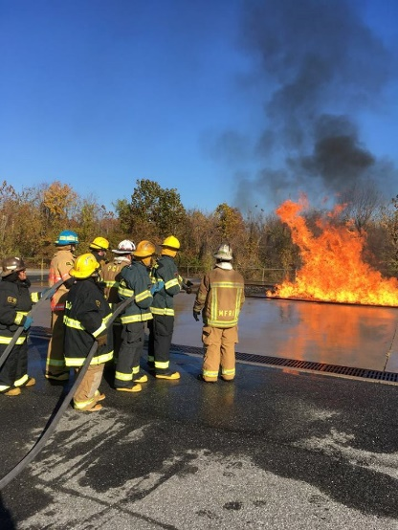
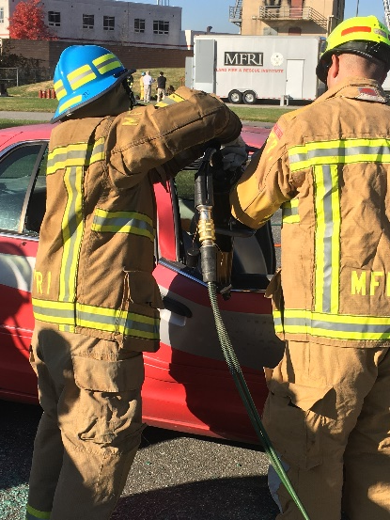
ADVOCACY
THANKS TO MFRI

Slide 5
ADVOCACY
Our Work with Federal Agencies
Office of the Vice President
FEMA Grants Office – AFG/SAFER Criteria Meetings
Department of Justice – PSOB Program
USFA – Conference calls, meetings and email exchanges
HUD – Meetings regarding fire sprinklers in subsidized housing

Slide 6
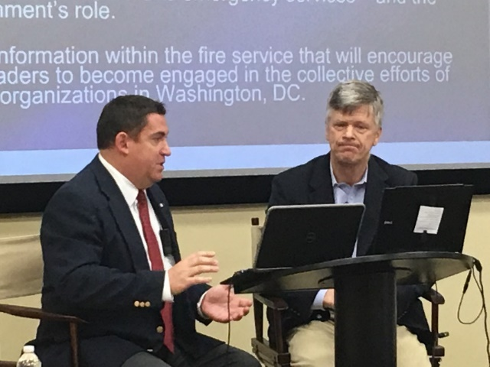
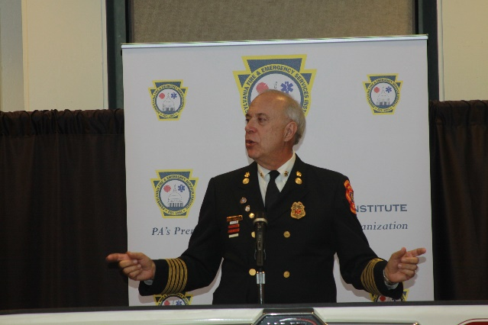
EDUCATION AND OUTREACH
Our Work Beyond the Washington Beltway
Presentations at conferences
Attended Trade Shows
Participated in webinars
Attended summits, coalition meetings and regional conferences
Spoke at banquets

Slide 7
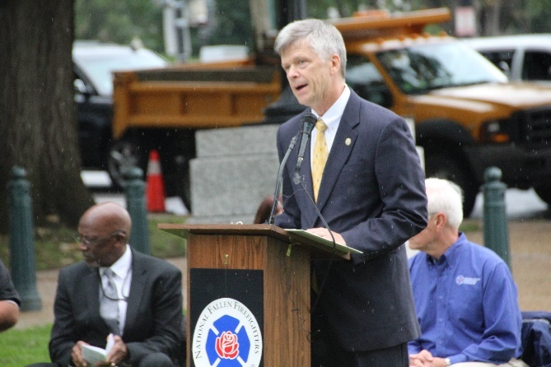
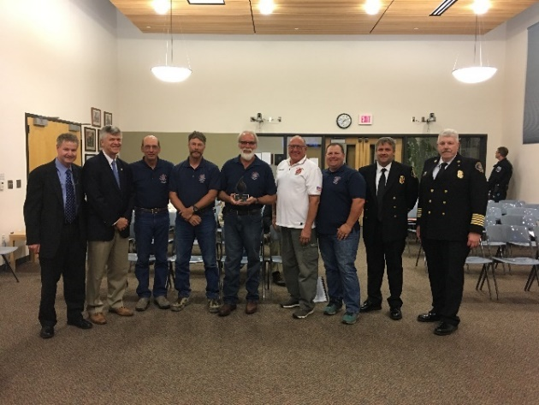
TRIBUTES AND RECOGNITIONS
Recognizing those who sacrificed and those who lead
Congressional Flag Presentation Ceremony
CFSI Awards Program
CFSI/Motorola Solutions Mason Lankford Fire Service Leadership Award
CFSI/NFFF Senator Paul S. Sarbanes Fire Service Safety Leadership Award
CFSI/IFSTA Dr. Anne W. Phillips Award for Leadership in Fire Safety Education
CFSI/Masimo Excellence in Fire Service-Based EMS Award
CFSI Legislator of the Year Award

Slide 8
COMMUNICATIONS
Getting the Word Out –
CFSI Website
Email Updates
Facebook
Articles for publications
We can do more…

Slide 9
FUNDRAISING

Slide 10
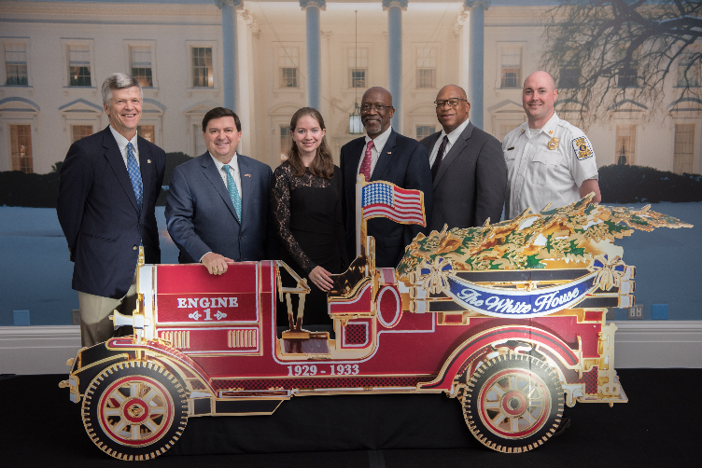
FUNDRAISING
Three Current Fundraising Programs –
Ornament Program
On-Line Silent Auction
Hockey Game
Ongoing Programs
CFSI Associates Club Program
Internship Program
Notes:
$20/ornament
On-line auction – runs through December 16th. Issued an advisory and posted information on our facebook page.
Hockey game – thank NFSA
CFSI Associates Club – renewals have been updated
Internship Program – thanks to E-One and FAMA

Slide 11
Notes:
Price increase – consistent with the recommendations in the Strategic Plan to increase the price after every third year. Price will be $350/ticket and $3500 for Bronze-level table

Slide 12
MANAGEMENT
Three-Year Strategic Plan
Thanks to the Kitchen Cabinet
Plan covers all aspects of our operations
NAC
The strength of our organization
Cooperation and consensus – instrumental in the work CFSI is able to perform

Slide 13
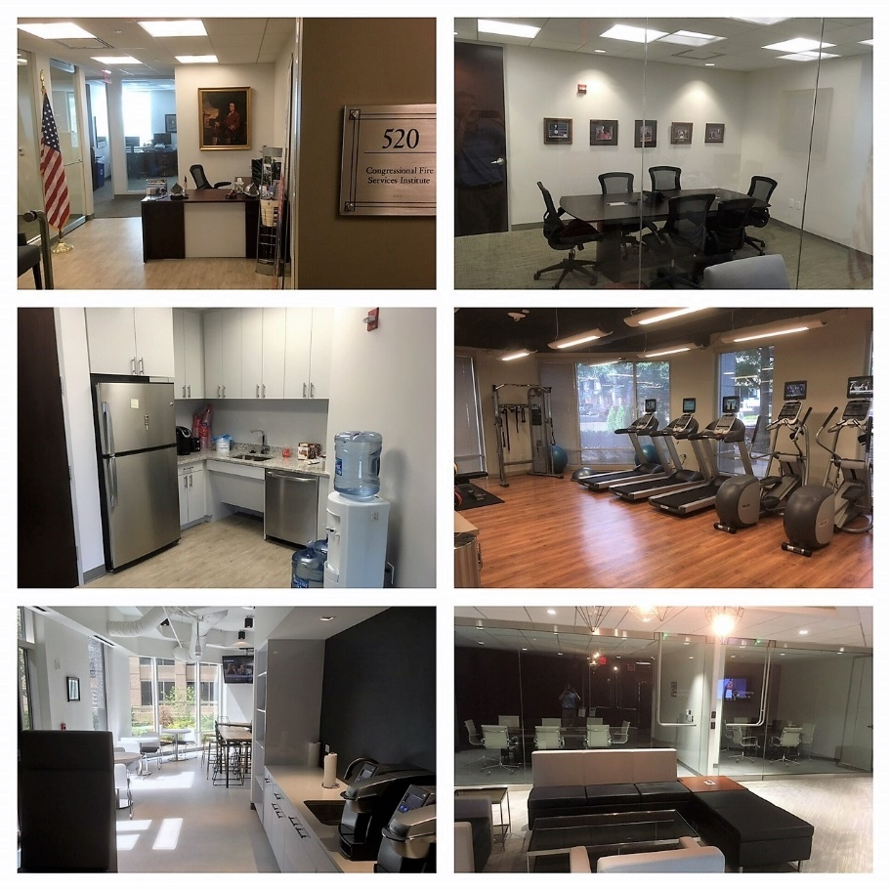
VISIT OUR NEW OFFICE
CFSI
1530 Wilson Blvd, Suite 520
Arlington, VA 22209
202-371-1277
Special Thanks to Jim Dalton and the
National Fire Sprinkler Association

Slide 14
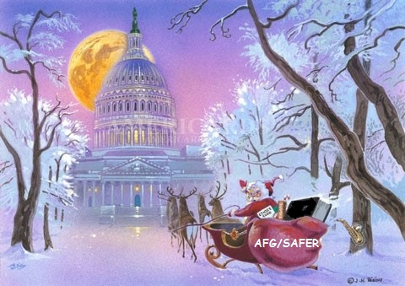
THANKS FOR YOUR CONTINUED SUPPORT & HAPPY HOLIDAYS

