Slide 1
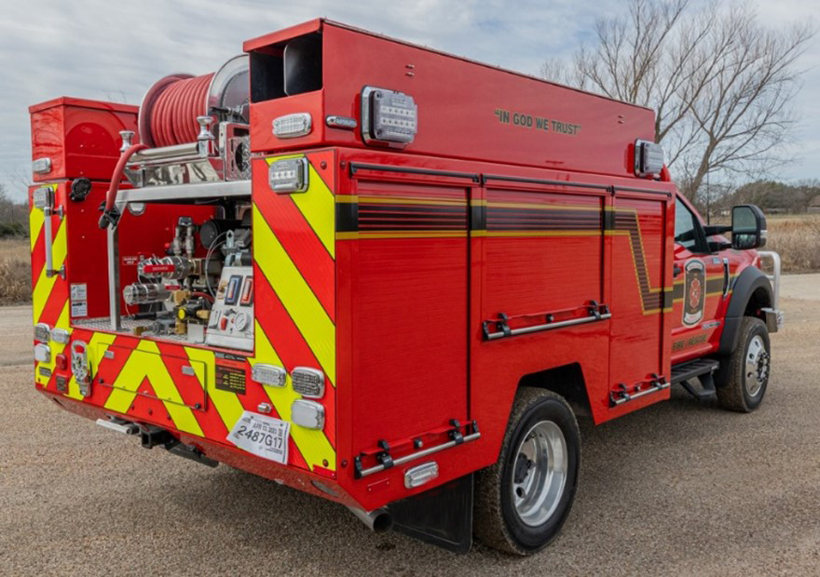
Figure 4: Representative Rescue-Wildland Combination

Slide 2
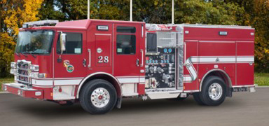
Figure 5: Representative Type 1

Slide 3
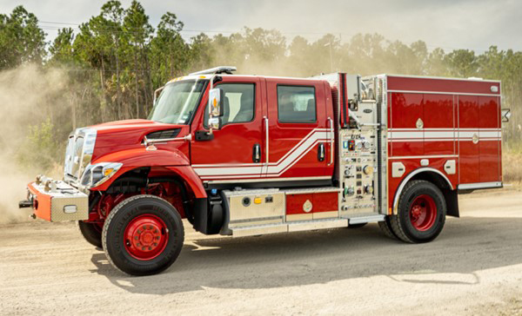
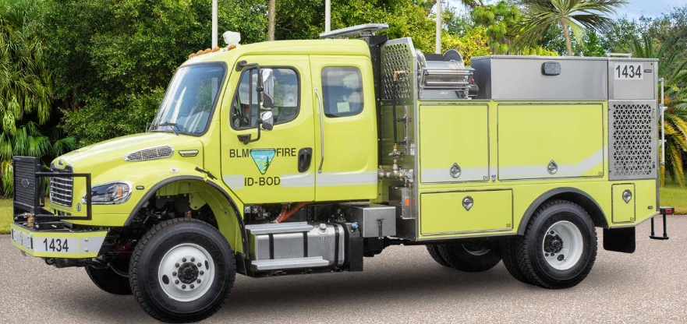
Figure 6: Representative Type 3
Figure 7: Representative Type 4

Slide 4
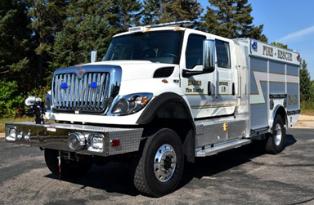
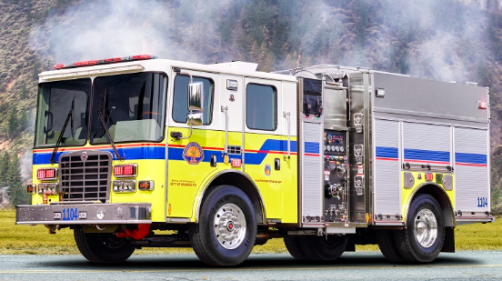
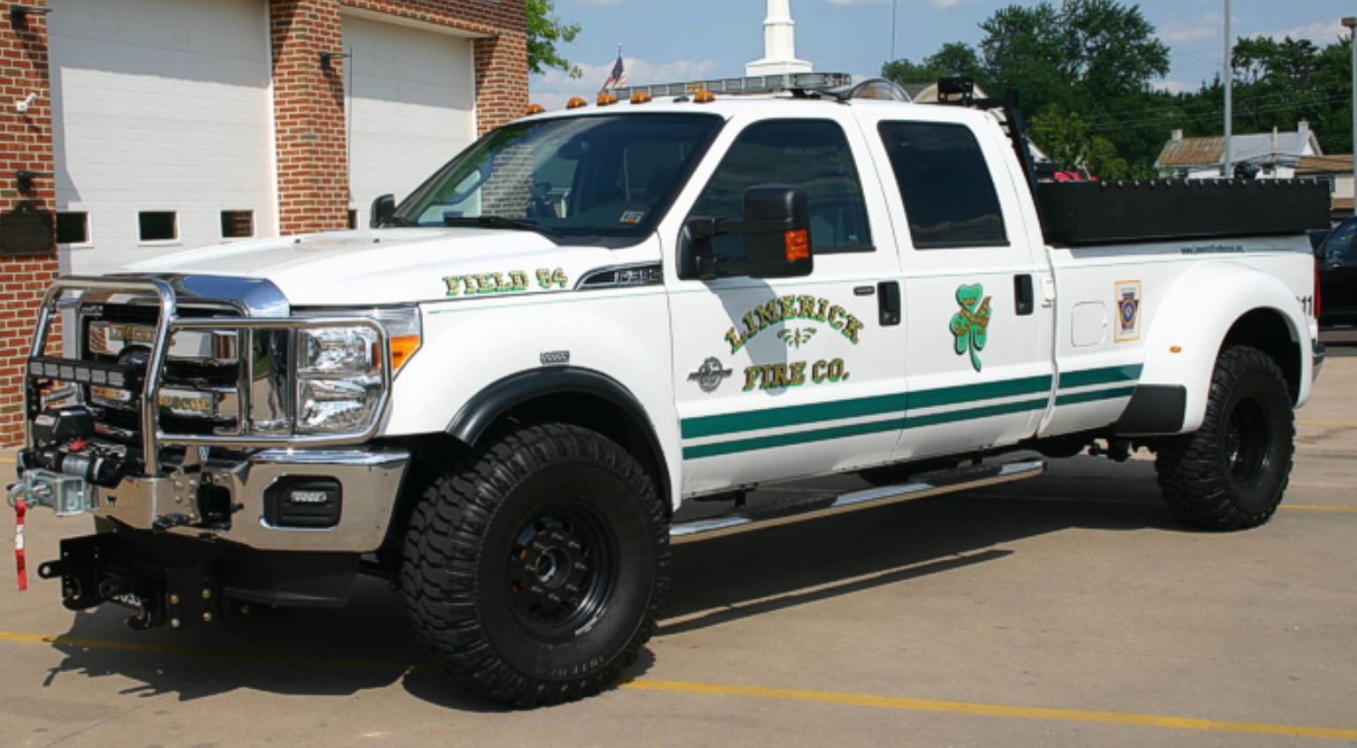
Figure 8: Representative Engine-Forward Commercial Chassis Wildland
Figure 9: Representative Type 1 Custom Chassis Wildland
Figure 10: Representative Type 7

Slide 5
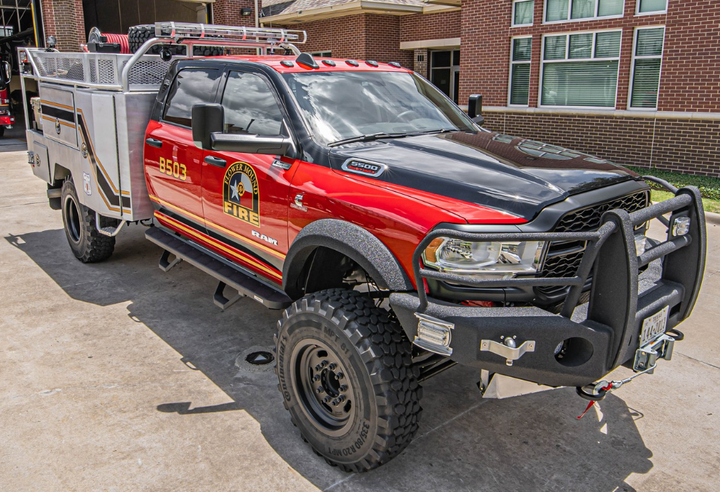
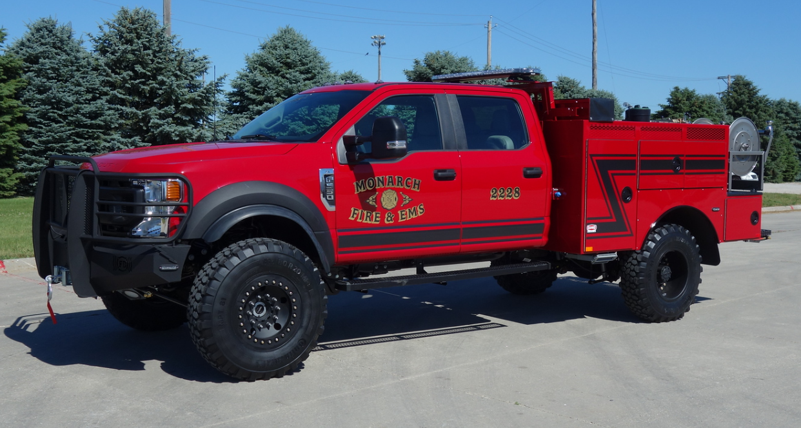
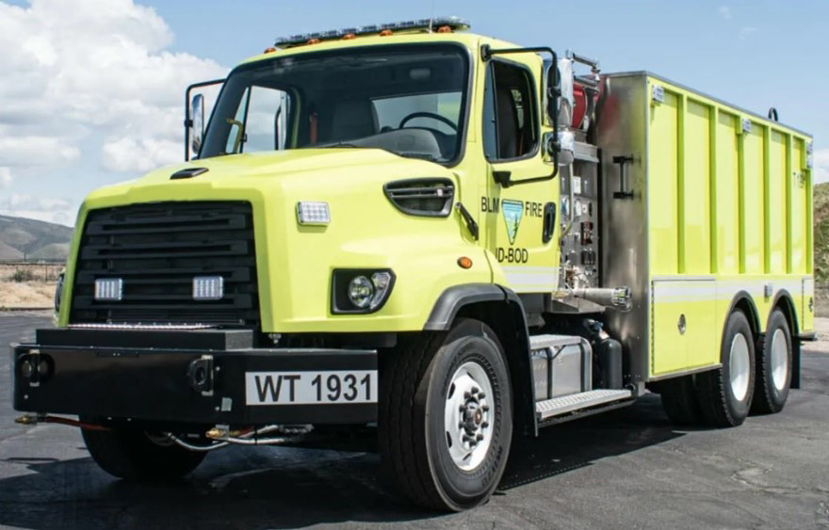
Figure 11: Representative Type 6
Figure 12: Representative Type 5
Figure 13: Representative Water Tender

Slide 6
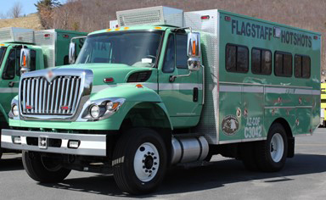
Figure 14: Representative Crew Carrier

